Slide 1
Number 4
Truly Intelligent Circuit Design and Implementation
Zhiyao Xie
Duke University
Advisors: Yiran Chen, Hai (Helen) Li
Notes:
Hi everyone, this is number 4.
I am Zhiyao Xie from Duke University. And my advisors are Prof …
The title of my talk is ‘Truly intelligent ……’.

Slide 2

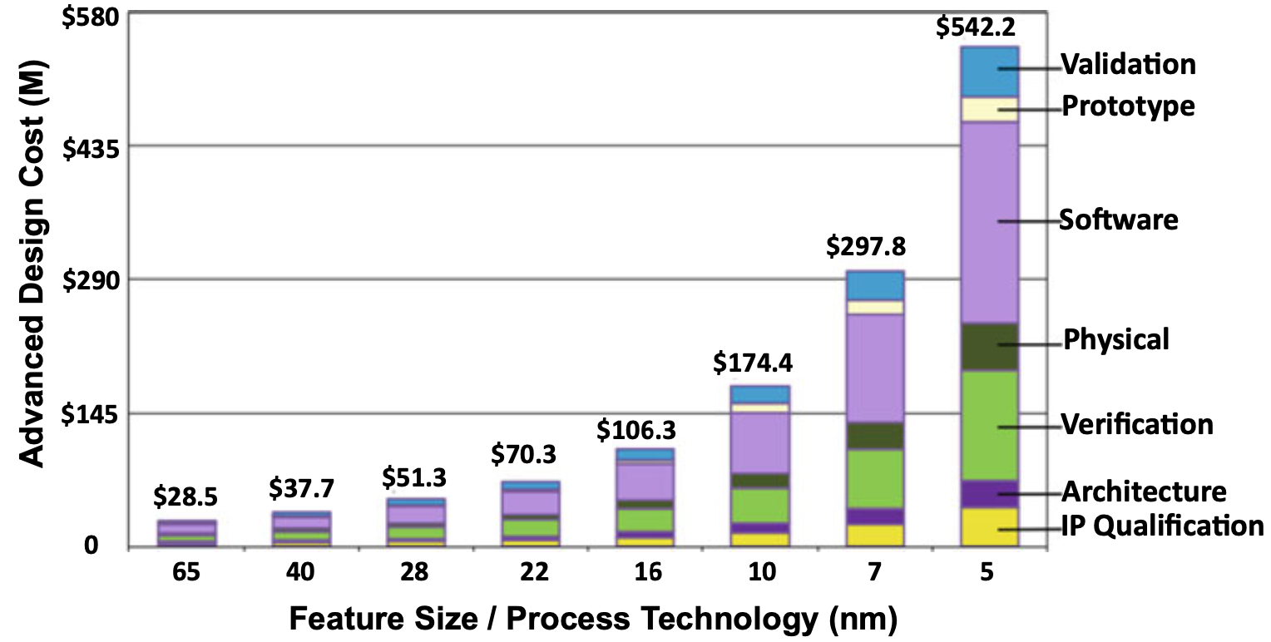
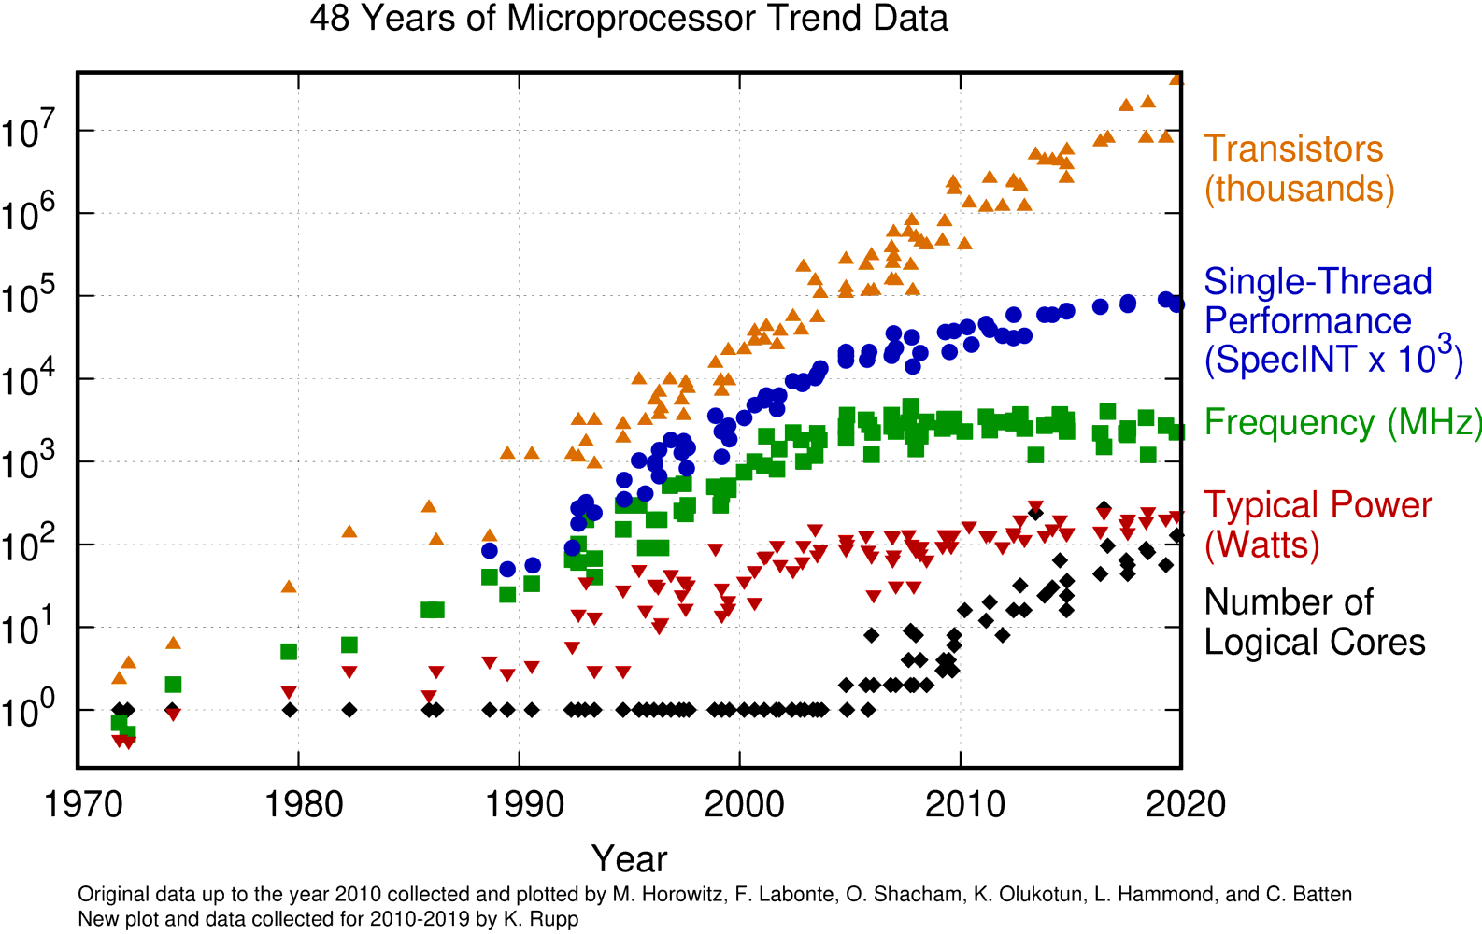
Chip Design Challenges
Diminishing performance gain and increasing design cost
Per-Core Performance Gain is Diminishing
Design Cost is Skyrocketing
(Not including manufacturing)
Partially collected by M. Horowitz et al. Plotted by Karl Rupp, 2020
International Business Strategies, 2020
Notes:
Integrated circuits are everywhere in our daily life, however, designers face a lot of challenges when they try to design new and better chips nowadays in 2021.
first, [click] [the performance gain of each CPU core is diminishing]. It means that it is difficult to get new generation of CPUs to run faster
The Second problem is cost, [click]. the design cost of circuit is skyrocketing, ....... It means that it's really expensive to design and deliver better chips.
Then here comes the question, why it's so difficult to design better chips nowadays, right?

Slide 3


This is Real Problem!
Challenges at advanced node
Inefficient chip design methodologies
Pressure from IPC and frequency
Peak power keeps increasing
Increasing design rules to meet
Increasing wire parasitics, causing wire delay and noise
……
For one Arm CPU core with ~3 million gates
Intelligent design methodologies
& solutions!
Accurate power simulation takes ~2 weeks
One iteration in physical design take ~1 week
Solutions repeatedly constructed from scratch
……
Source: The Kirin 990 SoC. TechInsights Inc.
Notes:
Well, actually there are many different challenges for chip design. [click ]
[First, designers face pressure to get better IPC and frequency in every generation of their product. ]
[As a result, the peak power keeps increasing. Also, designers have increasing design rules to meet and increasing wire parasitics. ] [click] [and a lot more challenges.]
In this case we really need .......
[click] for example, assuming I am a designer and I am working on this Arm CPU core with ~3 million gates] [click]
……
So both the challenges and inefficient design methodologies caused the chip design problems.
In order to solve them, we need some big and fundamental changes in how we design chips. And I believe [click] we need more
////
/Many researchers and engineers have extensively explored traditional solutions based on very excellent heuristic algorithms in past decades.

Slide 4
My Related Works
Power & Power Delivery Challenges
[ICCAD’20], [ASPDAC’20],
[MICRO’21] (Best Paper Award)
Power
Timing & Interconnect Challenges
[ICCAD’20], [ASPDAC’21],
[TCAD’21] (under review)
PPA
Performance
Routability Challenges
[ICCAD’18], [DATE’18], [ICCAD’21]
Area
Overall Flow Tuning
[ASPDAC’20]
Covered in this talk
Notes:
This slide shows my related works.
In this talk, I will cover my latest works on two topics as case studies, to demonstrate my effort in delivering true intelligence in circuit design and implementation.

Slide 5
Case Study 1:
Routability Challenges
Notes:
The first topic is about routability challenges.

Slide 6

My Roadmap Towards Intelligent Chip Design
True intelligence in chip design
ML for Chip Design
Well-studied in recent years
Traditional Chip Design
Source: Image adapted from Cadence Cerebrus.
Notes:
This is my roadmap towards intelligent chip design. I believe the first step we should go is machine learning for chip design. I will demonstrate this with one simple previous work, named RouteNet.

Slide 7



First Deep Learning Method for Routability Prediction
Task 1: which one will result in less DRV count?
Task 2: where are DRC violations?
cat / dog
Layout 1
Layout 2
Customized CNN methods
cat
Layout 1
Layout 1
Customized FCN methods
RouteNet [Xie, et al., ICCAD’18]
Notes:
In chip design, the routability is a measurement of the quality of routing, and it needs to be considered at early design stages.
For the routability prediction problem, I propose the first deep-learning-based solution in the world targeting two different tasks.
In the first task, we are interested in a more coarse-grained problem, which is, [click] given two circuit layouts before routing, which one will result in less DRC violation count? In other word, which one has better routability?
To solve this, [click] I proposed customized convolutional neural network (CNN) methods to process the circuit layout like images *classification*. And the label is one scalar value related to the DRC violation count we are interested in.
In the second task, we require a much more fine-grained prediction. [click] We need to point out precise locations of violations on this layout, such that the *mitigation techniques* can be applied.
To solve this, [click] I proposed fully convolutional network (FCN) methods to process the layout like image *segmentation*. The label will be the distribution of DRC violations on the layout.

Slide 8
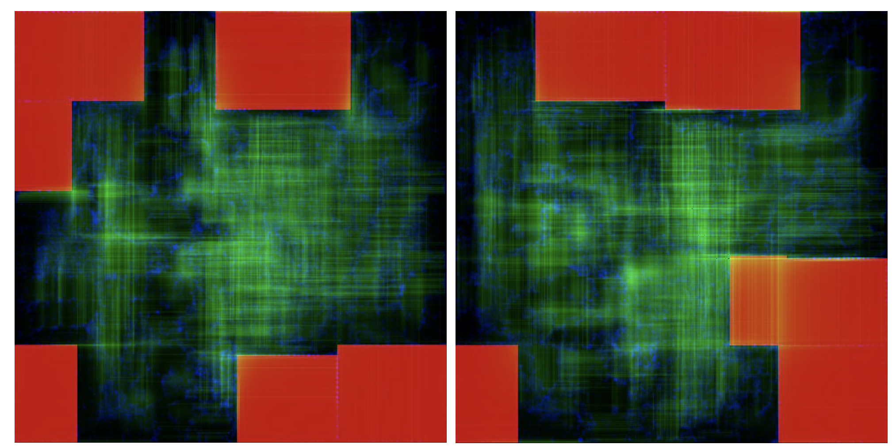
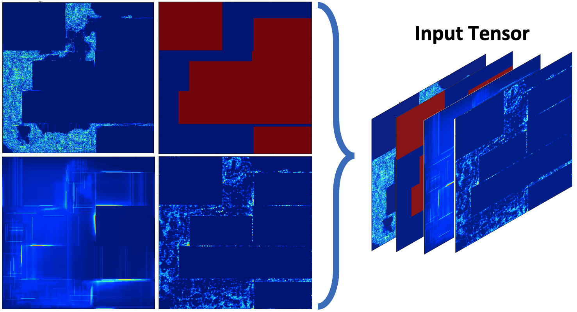
First Deep Learning Method for Routability Prediction
Task 1: which one will result in less DRV count?
Task 2: where are DRC violations?
Requires global routing:
Hours * Number of Layouts
In seconds, with close accuracy
Requires detailed routing
More hours * Iterations
In seconds, outperform previous works
RouteNet [Xie, et al., ICCAD’18]
Notes:
And these figures show what inputs from *real* circuits look like in both tasks.
In the first task, traditional evaluations like global routing will take *hours* to measure the violation count for each layout. In comparison, [click] our work only takes *seconds*.
In the second task, it takes even longer to find precise locations of violations. [click] And our methods also only take seconds.
[9.5 mins]

Slide 9
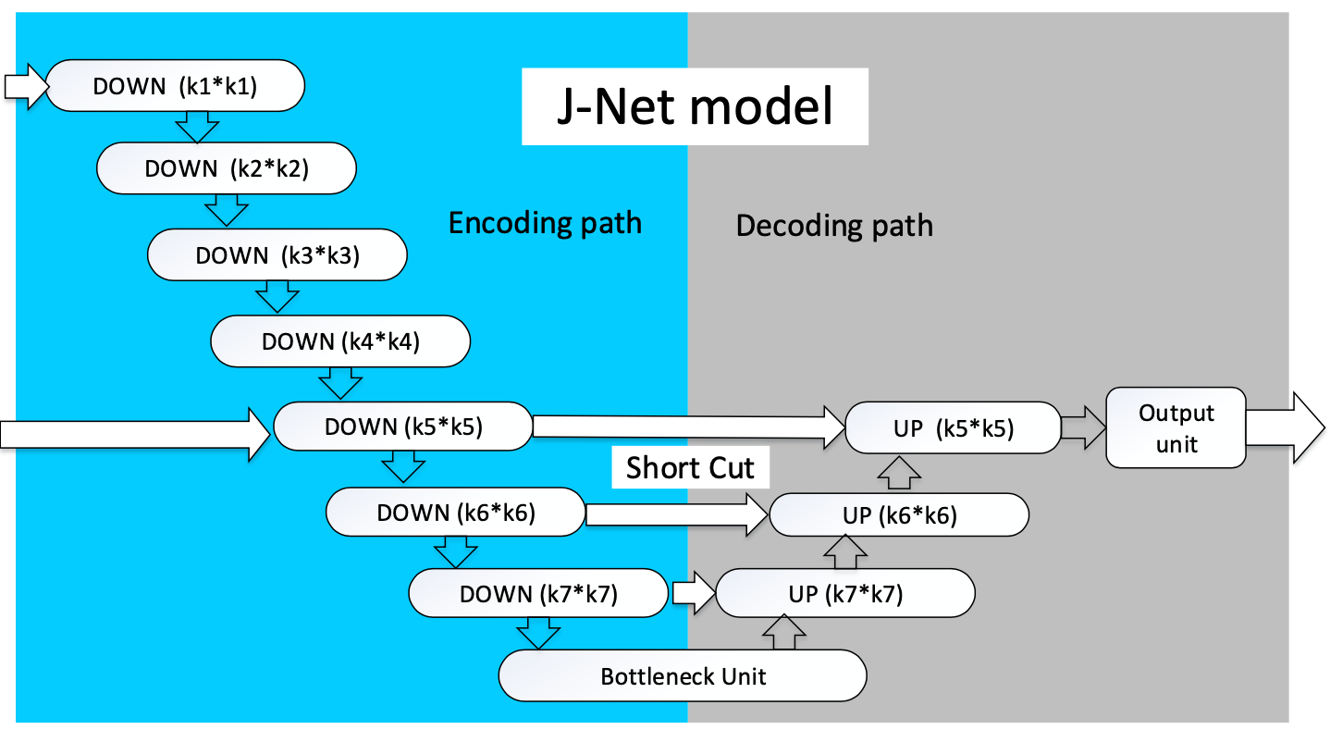
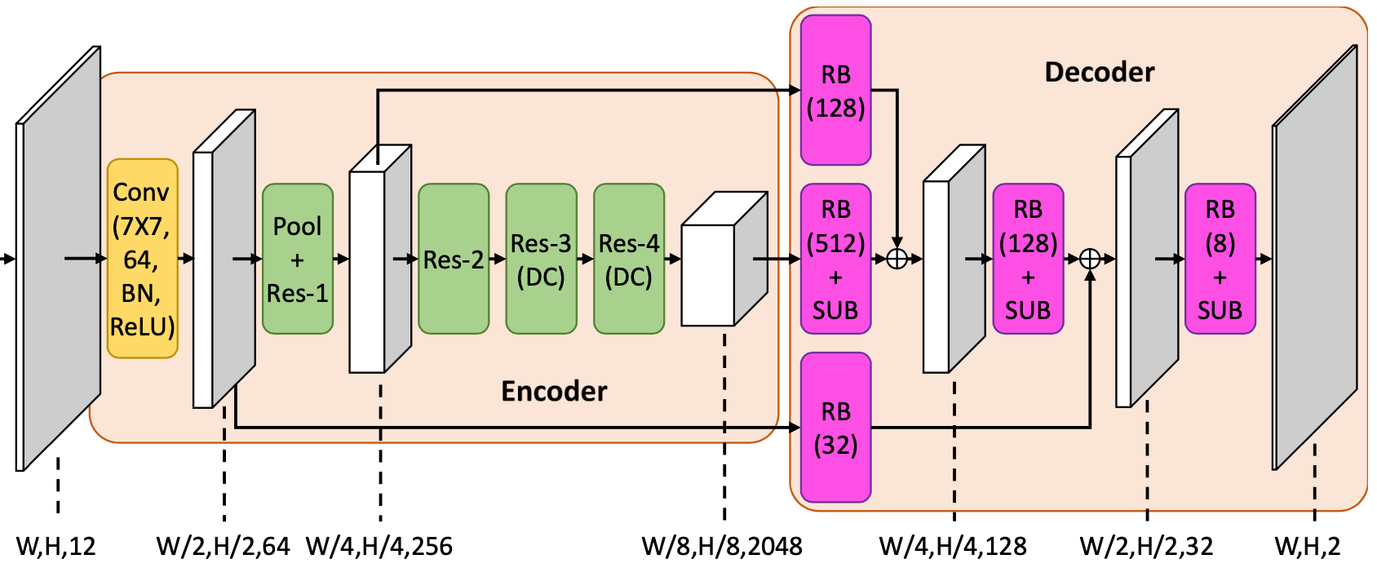


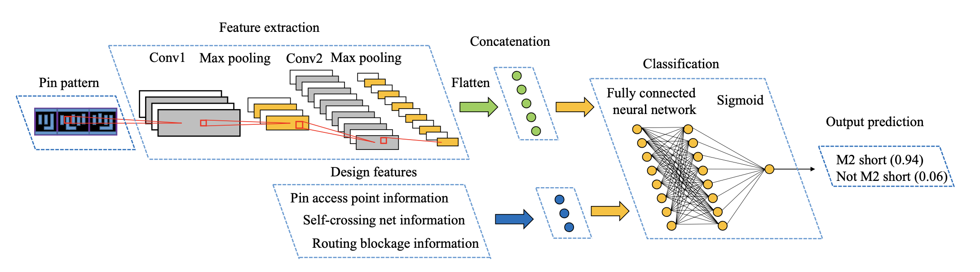
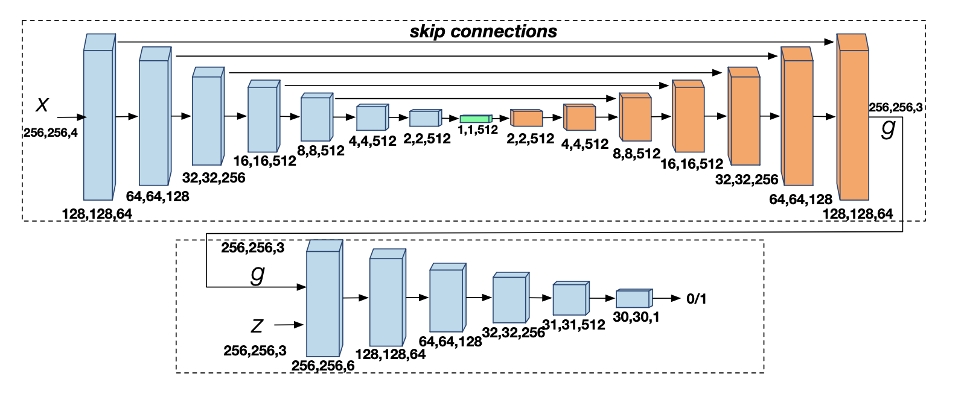


Many Excellent Deep Learning Methods
RouteNet [Xie, et al., ICCAD’18]
J-Net [Liang, et al., ISPD’20]
PROS [Chen, et al., ICCAD’20]
Tremendous Engineering Efforts Required!
[Yu, et al., DAC’19]
Painting [Yu, et al., DAC’19]
Notes:
After my first deep learning-based routability estimator, [click] we see a lot of excellent deep learning methods on this topic as routability estimators. Their methods are very carefully designed and achieve good results on their own benchmarks.
However, it is easy to see that these very well designed methods take a long time to develop. And also, [click] tremendous engineering efforts are required.

Slide 10
My Roadmap Towards Intelligent Chip Design
Auto-ML for Chip Design
True intelligence in chip design
ML for Chip Design
Higher-level of automation
Well-studied in recent years
Traditional Chip Design
Notes:
So it's natural for me to think we can actually avoid this cost by automating this model development step by auto-ml methods.
This works as a higher-level of automation. To illustrate this, I will introduce one of our latest work in automatically developing routability estimators.
[3 mins]

Slide 11
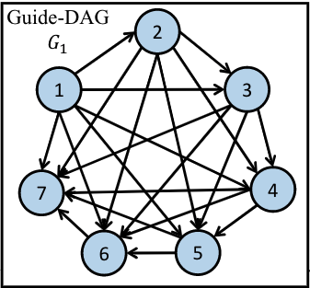


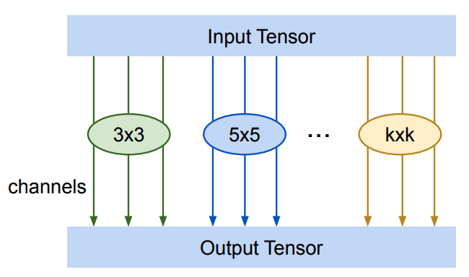
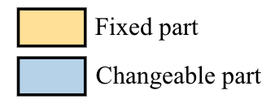
Automatic Estimator Development – Search Space
Candidate node operations
Atrous/dilated convolution
Mixed (depth-wise) convolution
Standard convolution
Sampling
[Chang, et al., ICCAD’21]
Notes:
This is my latest collaborative work in this ICCAD.
This figure shows the general model search space of our proposed routability estimator. There blue blocks represent large searchable parts.
Each blue block is independently sampled from this completely-ordered graph with seven nodes. Each node denotes one convolutional operation, selected from different options.
Each edge denotes the data path. As for the edges, since these edges are [- sampled from completely-ordered graph], So it supports any combinations of node connections.

Slide 12
DRC Hotspot Detection Results
12
This model outperforms RouteNet [ICCAD’18], PROS [ICCAD’20], and cGAN [DAC’19]
Developed without human in one day
ROC-AUC of DRC hotspot detection

Slide 13
Case Study 2:
Power & Power Delivery Challenges
Notes:
7 + 8 = 15 - 15.5 mins
So I have presented the concept of ML for chip design and auto-ML for chip design, using the challenges from routability problems.
The next and more important topic that I would like to discuss is power and power delivery challenges.

Slide 14
My Roadmap Towards Intelligent Chip Design
Unified ML for Both Design & Runtime
Auto-ML for Chip Design
True intelligence in chip design
Benefit the whole chip life cycle
ML for Chip Design
Higher-level of automation
Well-studied in recent years
Traditional Chip Design
Notes:
In this case study, I will introduce another latest work which achieves my higher goal. It is not only automatically developed, but also provides a unified ML model for both design and runtime, benefiting the whole chip life cycle.
So in this case, it's not only machine learning for circuits, but also machine learning in circuits.

Slide 15
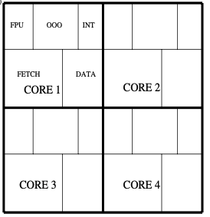




Challenge 1 – Design-time Power Introspection
256b SVE
256b
8-wide
Fetch
$$+$$
$$=$$
256b
256b
5-8-wide
Decode/Rename
256b
15-wide
Issue
$$+$$
$$=$$
256b
256b
Many-core CPU with more transistors
Wider issue
More vectored execution
Delivering generational performance gains adversely impacts CPU power
Power-delivery resources not keeping pace with CPU power demands
Increasing power-sensitivity drives the need for design-time introspection
APOLLO [Xie, et al., MICRO’21] (Best Paper Award)
Source: Arm Neoverse V1, 2021
Notes:
[pause]
I want to begin by the problems that drive this work. And that start with the fundamental trade-off between CPU performance and power-consumption.
As I introduced, CPU designers put significant effort in [delivering generational gains in performance]. However, this is increasingly difficult and requires more transistor integration, further parallelism and more vectored executions. It inevitably impacts the CPU power and current demand.
On the other hand, [click] [Power-*delivery* resources have progressed at a slower rate and unable to sustain the power demand of modern CPUs.
[click] Due to this [increased power sensitivity, there is a greater need for design-time power introspection]

Slide 16
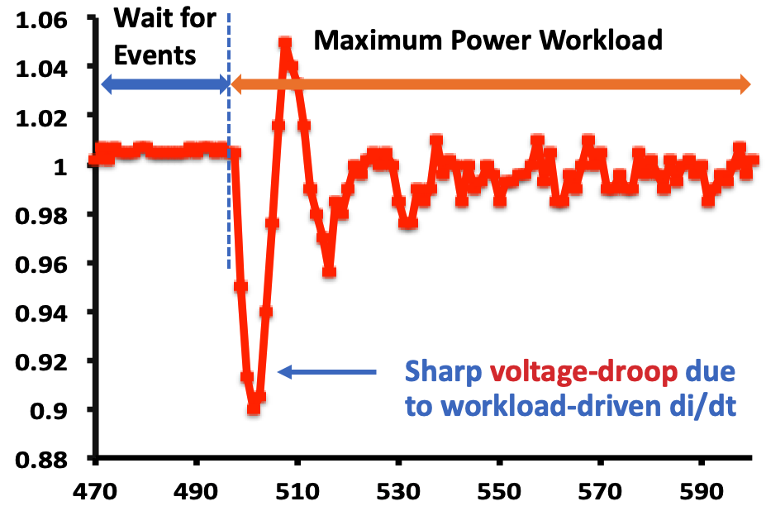
Challenge 2 – Run-time Power Introspection
Modelling power on one μarch block
Measured di/dt event on Arm A72 SoC
Different workloads
Ground Truth Power
On-Chip Supply Voltage (V)
Limited accuracy
Estimated Power with Manual Proxies
Time (ns)
Peak-Power mitigation requires accurate power estimation to drive throttling
Manually inferring proxies is very difficult in complex modern CPUs
Abrupt changes in CPU current-demand (di/dt event) leading to deep voltage-droop
Notes:
Not just design-time, modern CPU systems need power and thermal management at their runtime.
For example, peak-power mitigation techniques often rely on pipeline instruction throttling. The throttling algorithms are driven by manually inferred power-proxies. However, inferring proxies manually is very difficult in complex modern CPUs.
[click] A more serious problem is the [ abrupt changes in CPU current demand, named di/dt events], which leads to deep voltage-droops.
The sharp voltage droop develops in a very short time. This raises a high requirement on the response latency of mitigation or management techniques.

Slide 17
Power-Performance Trade-offs
Measured di/dt event on Arm A72 SoC
Generational gains in both IPC and FMAX
Wide issues queues, vector-execution
Power consumption is adversely impacted
Diminishing returns with scaling
Increased transistor integration
Power-delivery resources not keeping pace
Resistive-interconnects in scaled nodes
Package-technology unable to sustain di/dt demands
On-Chip Supply Voltage (V)
Deep voltage-droop due to workload-driven di/dt event
Time (ns)
Increasing power-sensitivity drives the need for power-introspection at design and runtime
Notes:
The problems we tackle in this work \ are power-delivery challenges caused by high-performance features in modern CPUs
[click] CPU micro-architects put significant effort \ in delivering generational gains in IPC and max-frequency. But It is increasingly harder.
[click] This impacts CPU power consumption, especially when efficiency gains through Moore’s law has stalled.
[click] Unfortunately, power-delivery resources progressed slower and unable to sustain the di/dt demands of CPUs.
[click] As a result, there is a greater need for power-introspection at both design and runtime.
/// and requires more aggressive speculation, further parallelism and specialized execution units.

Slide 18
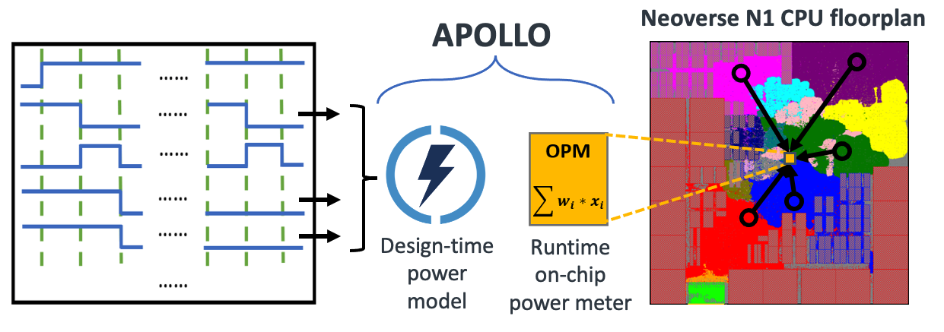
Challenges from Both Design-time and Runtime
A unified solution for both scenarios
APOLLO: A Unified Power Modeling Framework
Design-time Power Simulation Trade-offs
(Qualitative)
High accuracy & fast speed
Fast, yet accurate design-time simulation
Low-cost, yet accurate runtime monitoring
Design-agnostic automated development
Netlist Simulation
APOLLO
Low Accuracy High
RTL-Simulation
Arch Event-based
minutes
hours
days
weeks
Speed
Notes:
So, we encounter combined challenges from both design-time and runtime. And here is a summary of these challenges.
To address all problems, [click] I propose a unified power modeling framework targeting both scenarios, named APOLLO. [click]
Firstly, It provides fast and accurate power simulation at the CPU design-time. It finishes the power simulation of millions of cycles in minutes with 90-95% accuracy. More importantly, it allows unprecedented per-cycle temporal resolution.
[click]
And the APOLLO model can be directly synthesized as part of the CPU RTL. It achieves extremely low cost and accurate runtime on-chip power monitoring.
[click]
In addition, the development of this method is fully automated without human knowledge, and it is design-agnostic. It means that this method applies to all manners of compute solutions, not just different versions CPUs, but also GPUs, NPUs, and even sub-blocks.
So these are the strength of APOLLO, now I will start to introduce how we construct such a model.

Slide 19


Prediction Accuracy as Design-Time Power Model
Per-cycle prediction from APOLLO with $Q$=159 proxies
MAE = 7.19%
R² = 0.953
Neoverse N1 (infra)
Deployed in AWS Graviton
Cortex A77 (mobile)
Deployed In Snapdragon 865
Notes:
This figure shows the per-cycle prediction from the APOLLO model. Here it only includes 159 power proxies as input.
[click] We can see that the prediction trace in green curve has an excellent aggrement with the ground-truth envelope in pink.
We measure the prediction accuracy in [click] mean absolute error MAE and R-squared correlation. The MAE is around 7%.
The error is largely due to the small variations in cycle-by-cycle estimations. Because if you zoom in the curves in more details [click]

Slide 20





Summary and Takeaway
Problem: Increasing Challenges in Chip Design
Cost, time-to-market, reliance on designers, diminishing performance return, ……
ML in chip design
Less simulation time, faster feedback, less designer effort
AutoML in chip design
Reduces months of model development to hours, no developers
Unified ML in both design & runtime
Benefit the entire chip life cycle
Vision
Chip design & implementation
Truly Intelligent Solutions
Notes:
16 + 14 = 26.5 mins
And now it comes to the summary and the key takeaway of my talk.
My research is motivated by the increasing problems and challenges in chip design and implementation. To solve this, intelligent design methodologies and solutions are proposed.
[click]
The first and mostly studied solution is ML for chip design. Besides this, I believe there are higher goals we could target.
[click]
2. For example, We need AutoML in chip design, which relieve developers from the long development cycle of customized ML models.
[click]
3. In addition, we need ML in both design and runtime. In this way, it benefits the entire chip life cycle.
[click]
This bottom figure shows my vision. I want better chip quality with lower cost, also with less human engineering effort, shorter turn around time, and less computation and carbon emission.
Imagine I could improve chip performance by 30% with the same power consumption, while reducing both the number of engineers and the time-to-market by a half, what a huge profit it would make for every chip design company. And this is possible, because the traditional algorithm is far-from being perfect.

Slide 21
Thanks! Questions?
If you have further questions, please contact me:
zhiyao.xie@duke.edu

